Slide 1



Data Structure
&
Algorithm
Class VIII
lab 15

Slide 2

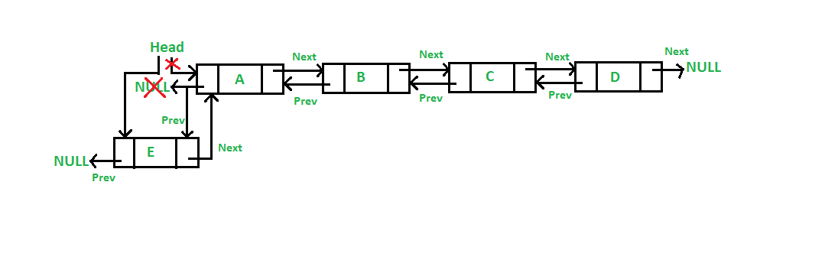
Doubly Linked List
Doubly Linked List is a variation of Linked list in which navigation
is possible in both ways, either forward and backward

Slide 3
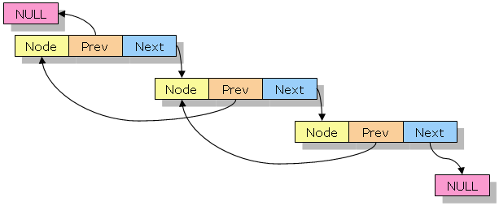
concept of doubly linked list
Link
Next
Prev
LinkedList

Slide 4
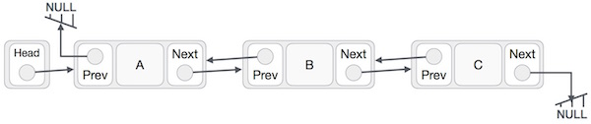
Doubly Linked List Representation
contains a link
Each link carries a data field(s)
Each link is linked with its next link
Each link is linked with its previous link using its previous link

Slide 5
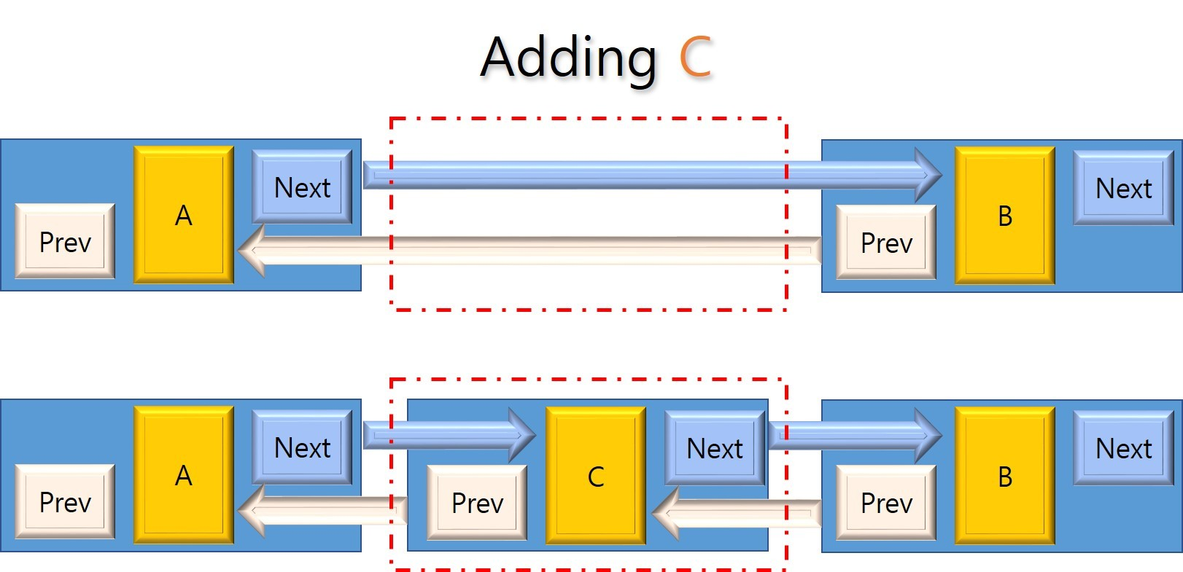
Basic Operations
Insertion
Deletion
Insert Last
Delete Last
Insert After
Delete
Display forward
Display backward

Slide 6
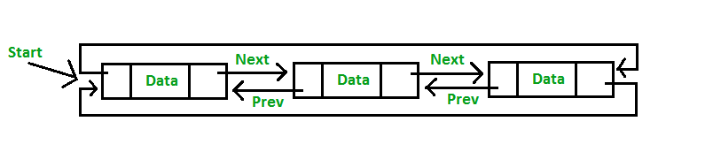
Circular Linked List
Circular Linked List is a variation of Linked list in which the first element points to the last element and the last element points to the first element

Slide 7

Singly Linked List as Circular
In singly linked list, the next pointer of the last node points to the first node

Slide 8

Doubly Linked List as Circular
In doubly linked list, the next pointer of the last node points to the first node and the previous pointer of the first node points to the last node making the circular in both directions

Slide 9


